Slide 1

Concept

Slide 2
CUSTOMER NAME
Devu Tools
PROJECT
YXA
PART NAME
Guard_Assy.Fr_Fender_Splash_R
PART NO.
77210-58Q00
TYPE
Checking Fixture
DATE
22-12-2024

Slide 3
Part Images
A Surface
B Surface

Slide 4
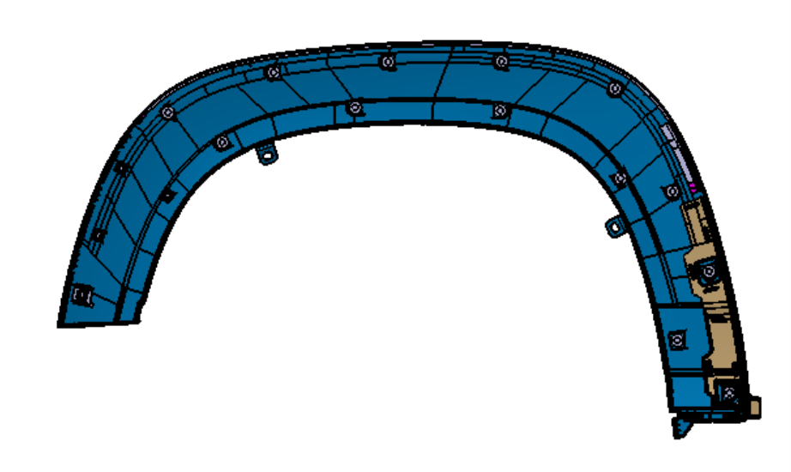
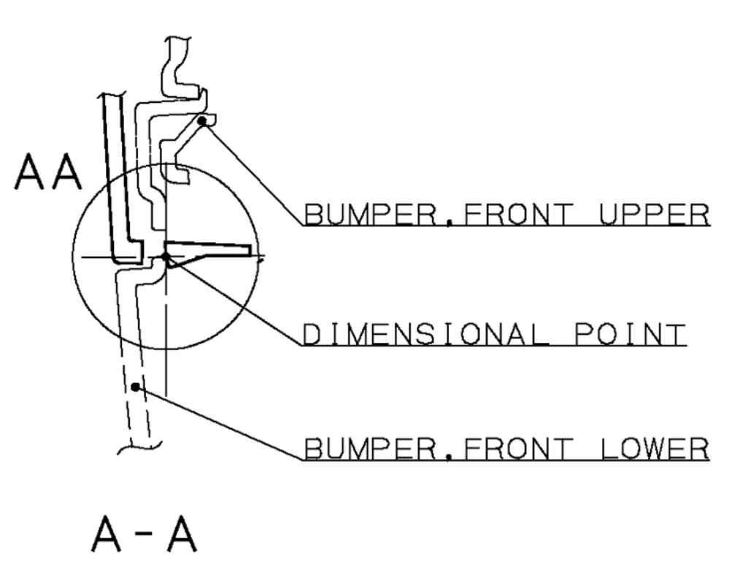
Resting & Locking
A-A
Part
Base Plate
A
Mechanism
Stand
A
Mechanism will be provided as per surrounding to lock the part in respective axis as sown above .

Slide 5

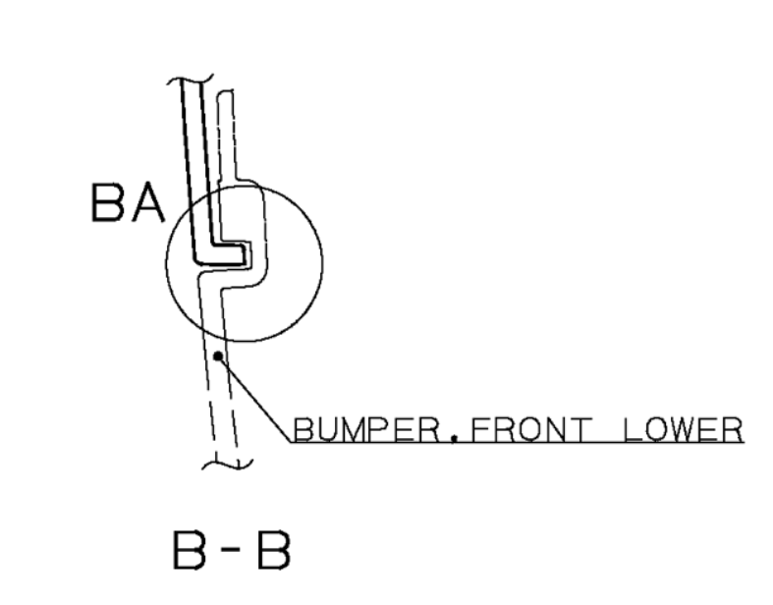
Resting & Locking
B-B
Part
Resting
B
B
Base Plate
Resting will be provided as per surrounding to lock the part in respective axis as shown above.

Slide 6
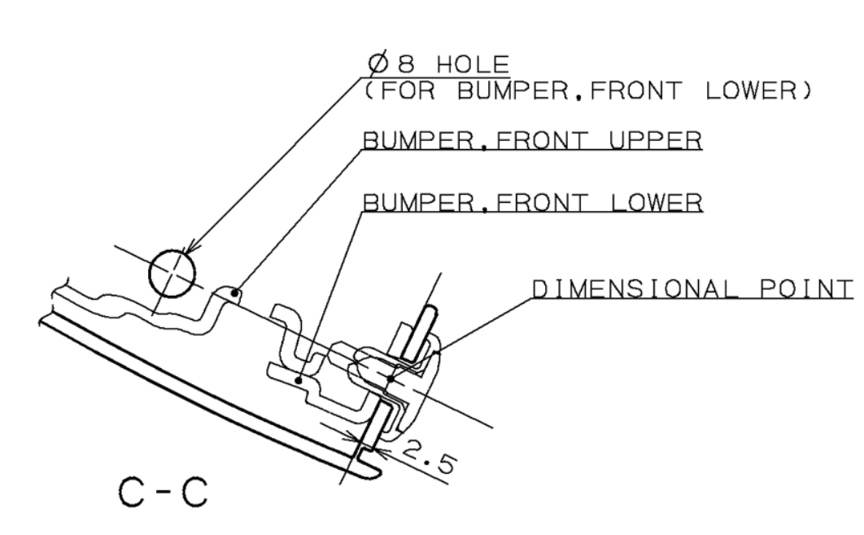
Resting & Locking
C-C
Part
C
C
Part Hole Size:-Ø8mm
Pin Size:- Ø7.9mm
Thread Pin
Base Plate
Thread pin will be provided to rest and lock the part in respective axis as shown above.

Slide 7

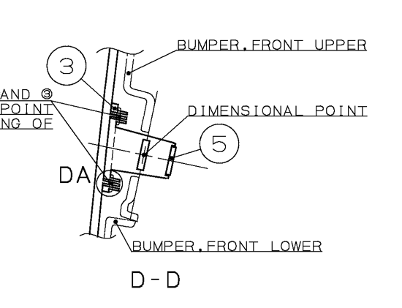
Resting & Locking
D-D
Mechanism
Base Plate
Part
D
D
Mechanism will be provided as per surrounding to rest and lock the part in respective axis as shown above .

Slide 8
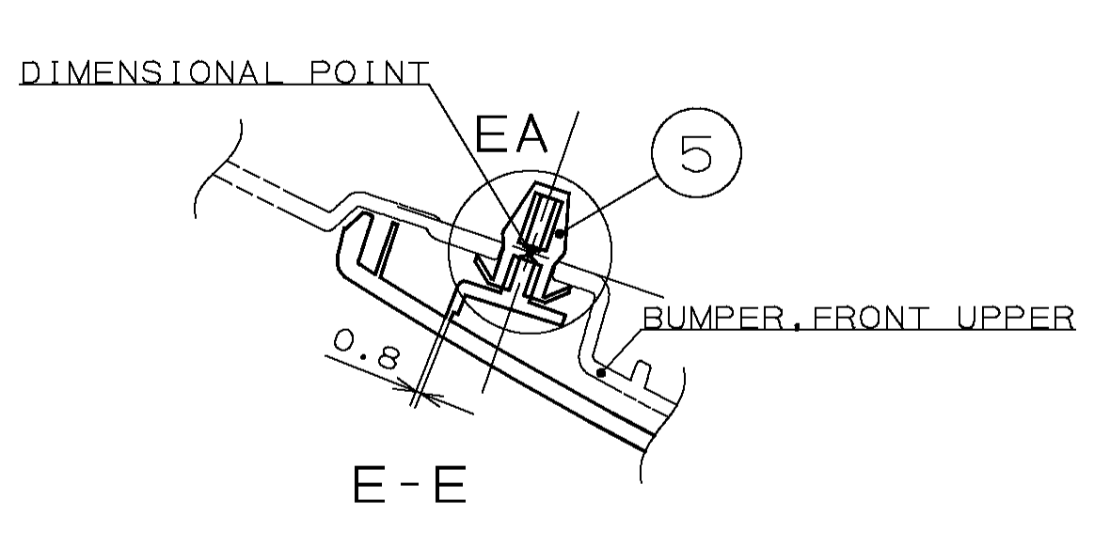
Resting & Locking
Stand
E-E
Mechanism
E
E
Part
Base Plate
Mechanism will be provided as per surrounding to lock and rest the part in respective axis as shown above .

Slide 9
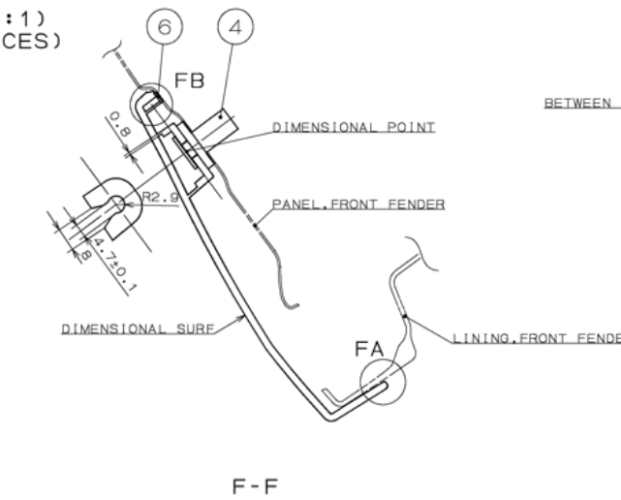
Resting & Locking
F-F
F
3
F
Mechanism
Part
Stand
Body
Base Plate
3
Mechanism will be provided as per surrounding and body will be provided with 3mm gap and 0,3 mm trimline all around the part as shown above

Slide 10
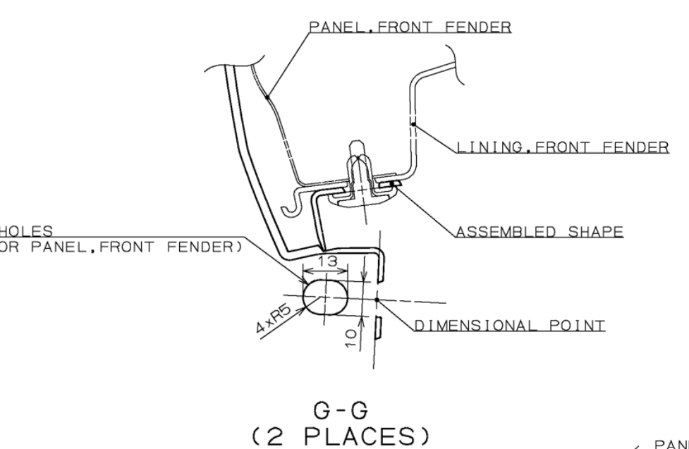
Resting & Locking
Part Hole Size:-Ø10mm
Pin Size:- Ø9.9mm
G-G
Part
G
G
Thread Pin
Stand
Note:-
Part required in Assembly condition
Base Plate
Thread pin will be provided at 2 places to rest and lock the part in respective axis as shown above.

Slide 11
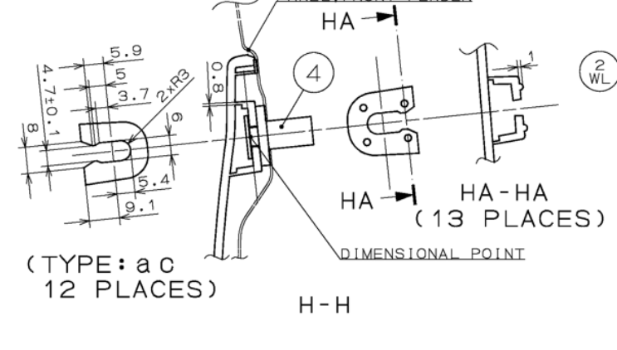
Resting & Locking
H-H
H
Part
Mechanism
Base Plate
H
Stand
Mechanism will be provided as per surrounding to lock and rest the part in respective axis at 12 places as shown above

Slide 12

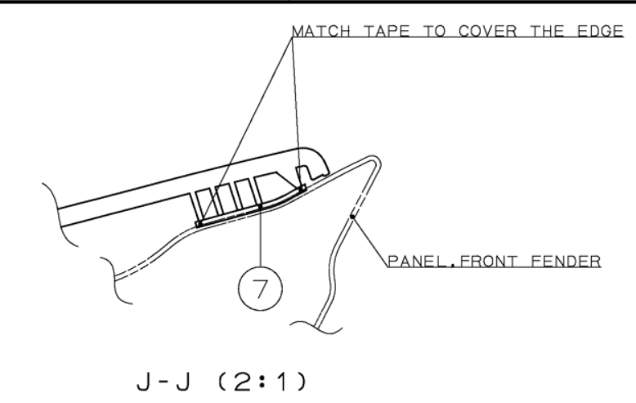
Resting
J-J
Base Plate
J
Body
J
Part
Note:-
Panel Front Fender Surrounding Required
Resting will be provided to rest the part as per surrounding as shown above

Slide 13
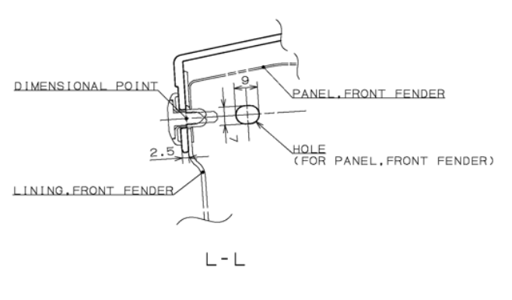
Resting and Locking
L-L
Stand
Base Plate
Part
L
L
Part Hole Size:-Ø7mm
Pin Size:- Ø6.9mm
Thread Pin
Thread pin will be provided to rest and lock the part in respective axis as shown above .

Slide 14
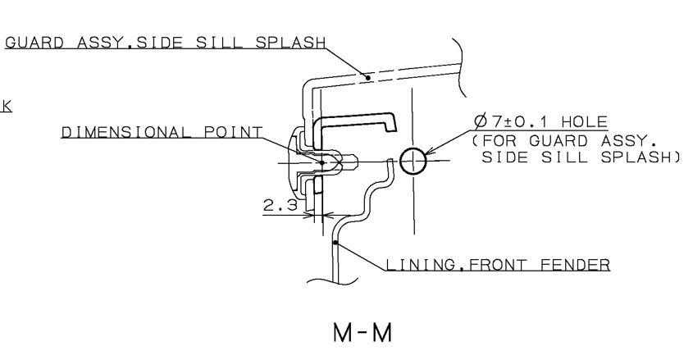
Resting and Locking
M-M
Stand
Part
M
Base Plate
Thread Pin
M
Part Hole Size:-Ø7mm
Pin Size:- Ø6.9mm
Thread pin will be provided to rest and lock the part in respective axis as shown above .

Slide 15
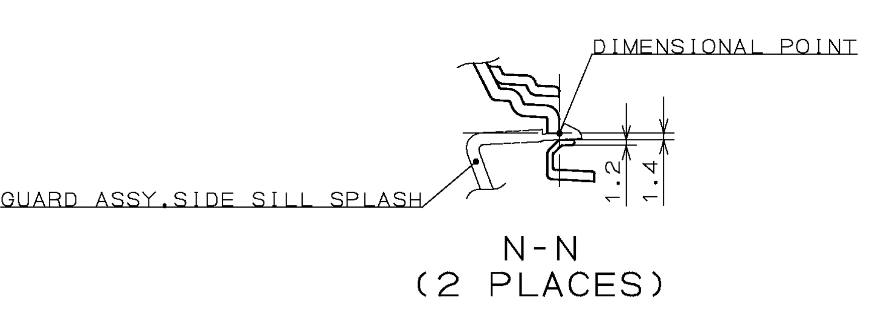
Locking
N-N
Part
Base Plate
N
Stand
Gap Template
N
Lock Pin
Slot checking will be provided inbuilt in the template at 2 places as shown above.

Slide 16
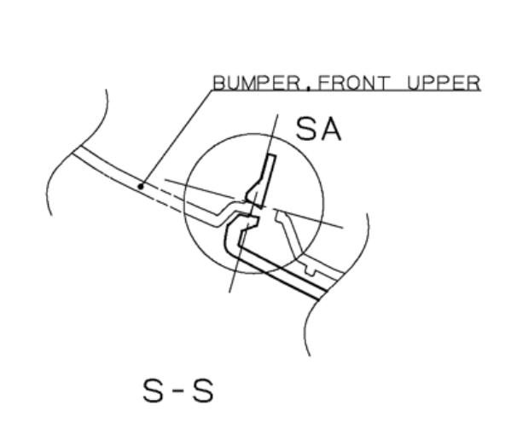
Locking
S-S
Base Plate
S
Mechanism
S
Part
Stand
Mechanism will be provided at 03 as per surrounding to rest and lock the part in respective axis as show above

Slide 17
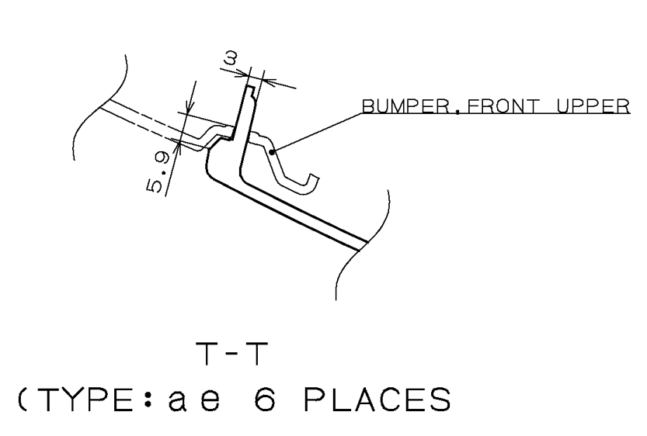
Locking
T-T
Base Plate
T
Mechanism
T
Part
Part
Stand
Resting will be provided as per surrounding at 06 places as shown above

Slide 18
Gap Trimline
Base Plate
U-U
U
3
U
Body
Part
3
Body will be provided with 3mm gap and 0,3 mm trimline all around the part as shown above .

Slide 19
Gap
V-V
3
Part
Base Plate
V
Stand
Gap Template
V
Lock Pin
Removable templates will be provided at both the end with 3mm gap as shown in above image .

Slide 20
Fixture Orientation
Isometric
Top
Front
Side

Slide 21
Thank You

